Slide 1
Woohoo!! Your first Earth Warm-up!
30 January 2020
What are some topics that we will cover in this class?
2. Which of these do you already know something about?
3. Are there any that you haven’t studied at all before? Which ones?
Geology: plate tectonics, rocks & soil, energy resources, water on Earth (freshwater & oceans)
Astronomy: Earth, sun, moon relationship
Ecology: interactions between humans & Earth’s resources

Slide 2
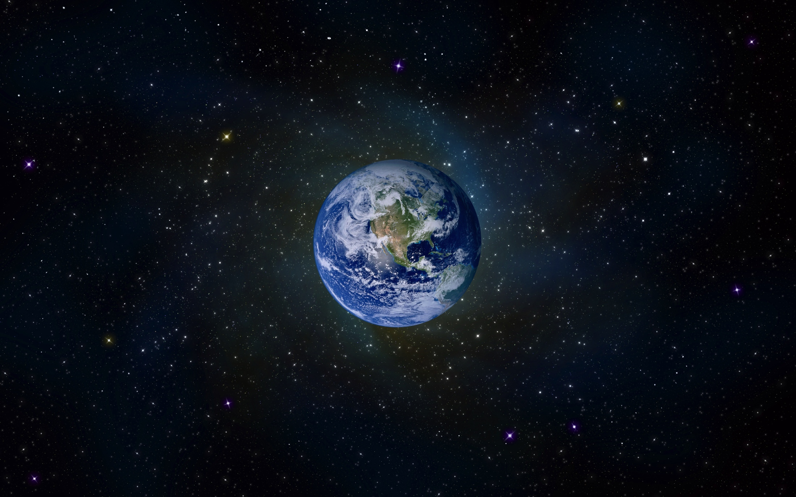
Introduction to Earth Science

Slide 3
A View of Earth
Earth is composed of 4 major spheres:
Hydrosphere: the water portion
Atmosphere: the gaseous portion
Geosphere: the solid surface (crust, mantle, core)
Biosphere: ALL life forms on the planet
Largest ecosystem
Ecosystem: community of organisms and the environment they inhabit.
We will study all except the biosphere.
(covered in biology)
Notes:
Sphere=from the Greek sphaira, meaning ‘ball, globe.’
Hydro=from the Greek hudōr, meaning ‘water.’
Atmo=from the Greek atmos, meaning ‘vapor.’
Bio=from the Greek bios, meaning ‘(course of) human life.’

Slide 4
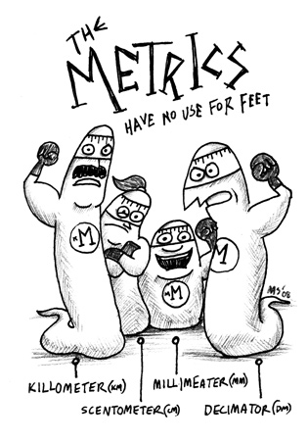

Slide 5
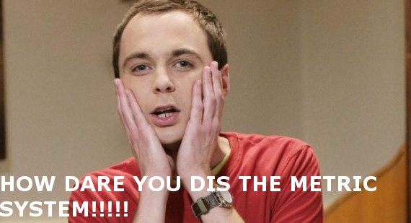
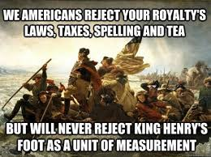
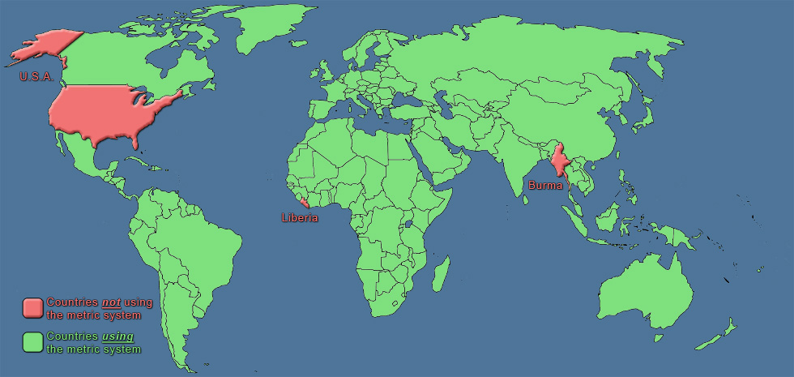

Slide 6
The Metric System
The metric system is also known as the international system of measure (abbreviated as SI, from the French ‘systeme internationale.’).
It is the ONLY measuring system used in the scientific community. Therefore, it is the ONLY system used in this class.
ALL measurements consist of TWO parts:
Number
Unit

Slide 7
Base Units you MUST Know
Length = meter (m)
Volume = liter (L)
Mass = gram (g)
Weight = Newton (N)
Time = second (s)
Temperature = degrees Celsius (ºC)
Further Information:
Density = mass/volume (g/mL)
Density of water = 1 g/mL
Volume of a solid can be calculated as length x width x height
Units: m³ or cm³

Slide 8
Metric Prefixes
Prefixes are used to distinguish between the size of units (m vs. km or g vs. kg)
Most important to us:
Kilo = 1000
Centi = 1/100
Milli = 1/1000
x1000 | x100 | x10 | Base Unit | /10 | /100 | /1000
Kilo- | Hecto- | Deka- |  | Deci- | Centi- | Milli-
km | hm | dkm | m | dm | cm | mm
BIG
small

Slide 9
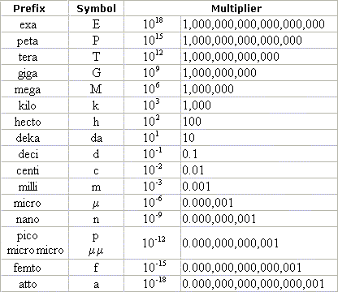
BIG
SMALL

Slide 10
Common Conversions
Mass:
454 grams = 1 pound
Length:
2.54 cm = 1 inch
10 km = 6.24 miles (running a 10k race)
Temperature:
100 ºC = 212 ºF
0 ºC = 32 ºF
Formulas:
°F to °C - Deduct 32, then multiply by 5, then divide by 9
°C to °F - Multiply by 9, then divide by 5, then add 32

Slide 11
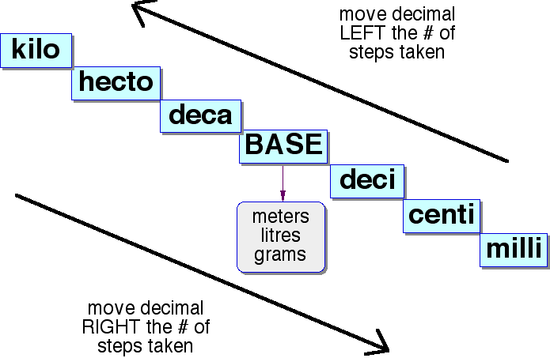
King Henry Died by Drinking Chocolate Milk

Slide 12
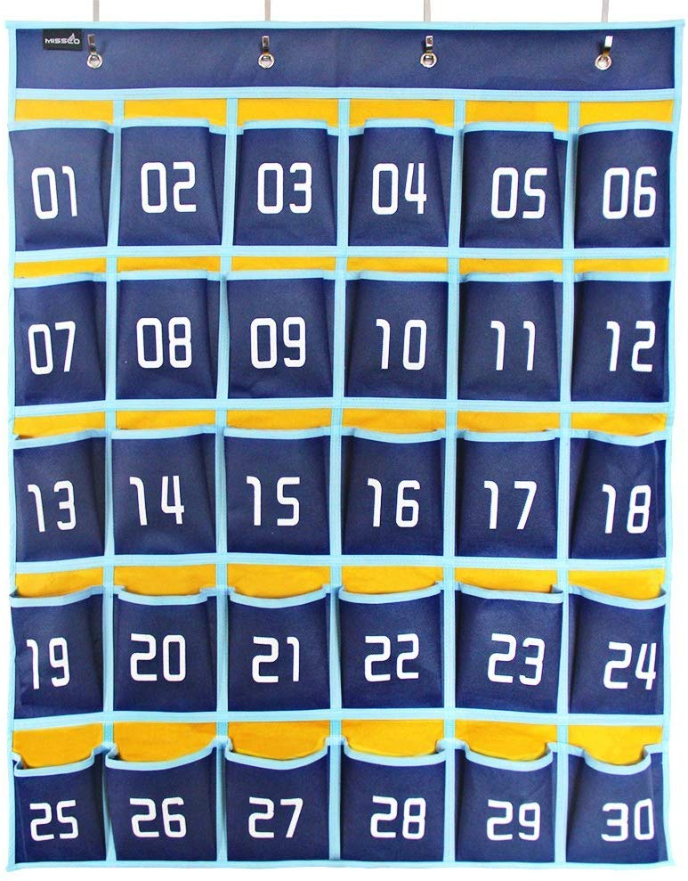
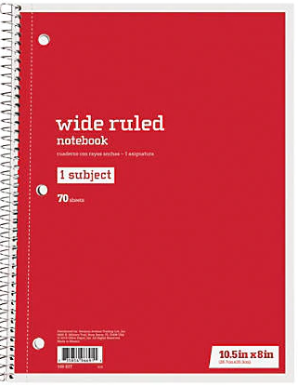
By 7:25, please:
1. Put up your phone
(# located beside your name to right of
phone holder)
2. Find your warm-up notebook. (in turquoise bin)
3. You should have received your Measurement & Density Lab back.
4. TURN IN M&M LAB BY 7:25 (IF NOT ALREADY IN)
YOUR NAME

Slide 13
3 Feb 2020
(Remember to copy the question first)
1. How many cm are in a meter?
2. How many grams are in a kilogram?
3. Practice conversion problems:
3 m = ________ cm = _________ mm
4000 L = ________ kL = _______ mL
4500 g = ________ mg = _______ kg
4. How many centimeters are in 1/2 meter?
5. Given: 1 mL = 1 cm³ = 1cc
1 L + 500 mL + 4cc + 60 cm³ = ________ L = _______ mL
100
1000
300
3000
4
4,000,000
4,500,000
4.5
50
1.564
1,564
mL mL

Slide 15
The Scientific Method
Also known as the Scientific Process
Scientific Method: An organized, logical approach to scientific research.
NOT a set of sequential steps that scientists follow!
Guide to problem solving

Slide 16
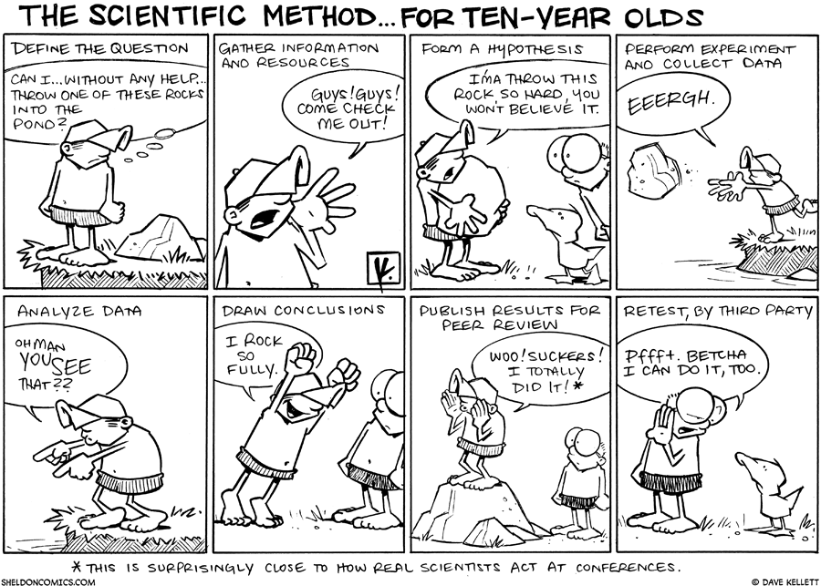

Slide 17
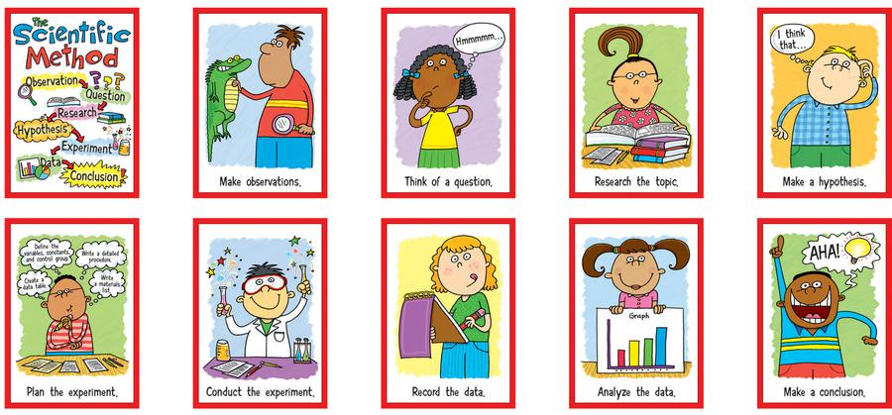

Slide 18
General Steps of Scientific Method:
State the Problem
Often begins as a result of an observation which leads to questioning.
Gather Information
Often involves taking measurements, which are a comparison of something to a standard unit.
Form a hypothesis
Hypothesis: A proposed solution or explanation of the problem.
Test the hypothesis
Must have a great deal of supporting evidence
Tested by experimentation.
Scientists test a variable.
Variable: a factor that can be changed.
Involves the use of many controls.
Control: Factor that remains the same.
Analyze the results.
State the conclusion.
The hypothesis can either be accepted as stated, changed slightly, or thrown out altogether.

Slide 19
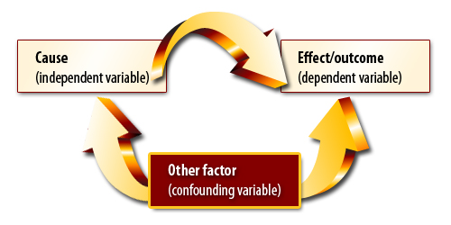
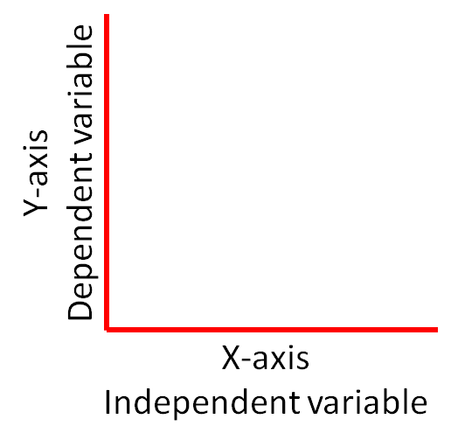
Independent variable-
What is being manipulated in an experiment
Dependent variable-
What is being measured as a result in an experiment
Confounding variable-
Unplanned variables that interfere with the results
TITLE – include BOTH IV & DV

Slide 21
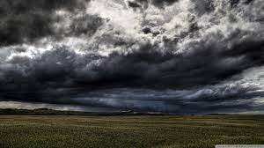
Observations vs Inferences
Inferences are:
based on observations.
They may or may not be true.
For example, if you observed more and more clouds that were darker and darker, what INFERENCES could you make?

Slide 22
Types of Data:
Qualitative Data
Descriptions.
Data can be observed but not measured.
Colors, textures, smells, tastes, appearance, beauty, etc.
Qualitative → Quality
Quantitative Data
Numbers.
Data which can be measured.
Length, height, area, volume, weight, speed, time, temperature, humidity, sound levels, cost, members, ages, etc.
Quantitative → Quantity

Slide 23
By 7:25, please:
1. Put up your phone
(# located beside your name to right of
phone holder)
2. Find your warm-up notebook. (in turquoise bin)
3. Metric Mania (#5) is on your table – didn’t get yesterday due to fire drill
YOUR NAME

Slide 24
31 Jan 2020
(Remember to copy the date & question first)
Give an example of a metric unit.
2. What would you measure with the unit you selected? (give an example)
3. Where in the world is the Metric
System used?
4. Who doesn’t use metric?
Meter, liter, degrees Celsius, gram (many variations)
I am 1.5 m tall. I buy soda in a 2L bottle. Today will be 16ºC.
A soccer ball has a mass of 440 grams.
ALMOST everywhere –
only 3 countries DON’T use it. L
Liberia, Burma/Myanmar, and the United States

Slide 25
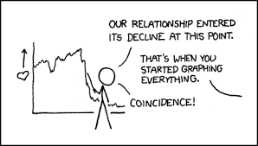
SCIENTIFIC GRAPHING

Slide 26
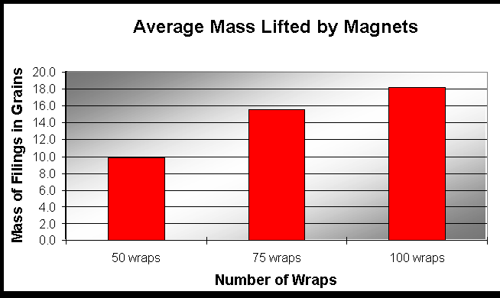
Which of these is easier to read?
The graph?
Or the data?
If there are 50 wraps around a magnet, the average mass lifted is 10.0 grains of filings. When the magnet is wrapped 75 times, 14.8 grains of filings can be lifted. However, when the magnet has 100 wraps, a total of 18.1 grains of filings can be lifted.

Slide 27
Types of Graphs
Bar Graph
A visual display used to compare the amounts or number of times that something occurs
Ex – different types of candy bars in an assorted bag
Pie Graph
A visual display to show percent of a whole
Ex –different sources of electricity in US

Slide 28
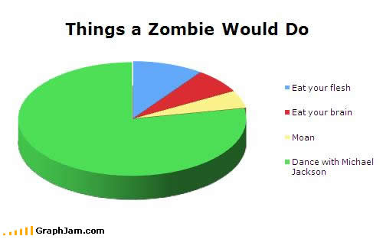

Slide 29
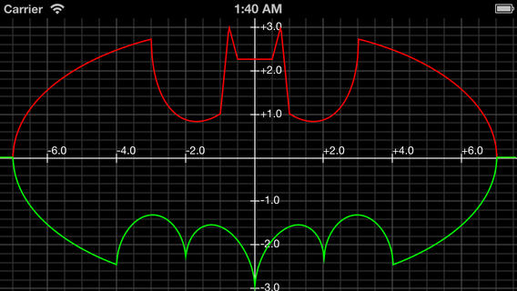
Line Graph
A visual display to show how something changes over time by connecting points
Ex – a person’s height over their lifetime

Slide 30
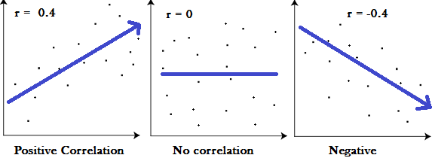
Scatter Plot Graph (a type of line graph)
Usually consist of large amounts of data and are used to show a relationship
Ex – how many bluegill are in the GHHS wetland at each water temperature
Can be used to demonstrate correlation
the closer the data points come to making a straight line, the closer the relationship and therefore the stronger the correlation

Slide 31
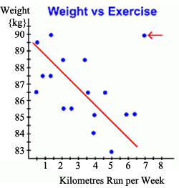
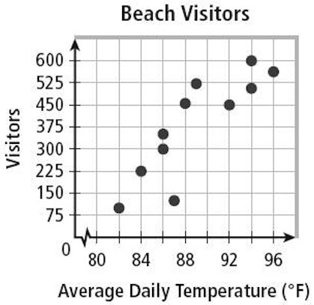
Which is positive? Which is negative?
Negative correlation
Positive correlation

Slide 32
ALL scientific graphs must:
Have a proper title
Have a Y axis label (with units)
Have an X axis label (with units)
Start at zero
Have equal distances between each number and use at least 75% of the axis
Have a key if using more than one data set

Slide 33
By 7:25, please:
1. Put up your phone
(# located beside your name to right of
phone holder)
2. Find your warm-up notebook. (in turquoise bin)
3. Today’s Warm-Up is on the table. Please GLUE it into your warm-up book & complete.
YOUR NAME

Slide 34
4 Feb 2018
IF the coin is larger, then more drops of water will fit on it.
What is the independent variable?
What is the dependent variable?
List several constants. (things that must be kept the same)
4. List two examples EACH of qualitative and quantitative data
that you might gather for this experiment.
5. Draw a graph that shows what
these results might look like.
(yes – you need to create fake data)
Size of the coin
Amount of water
Same dropper, same size drops, all new coins, same temperature
AND LOTS MORE
Does size of the coin determine the amount of water held?
Amount of water
D
P
N
Q
Size of the coin

Slide 35
MAPPING
Representing Earth’s Surface

Slide 36
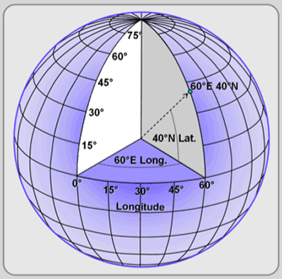
The Earth is a sphere, so how do we describe where a point is on its surface?
The most common way to locate points on the surface is by geographic coordinates (latitude and longitude)
These coordinates are measured in degrees and represent angular distances calculated from the center of Earth.

Slide 37
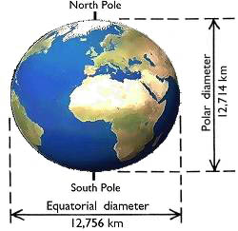
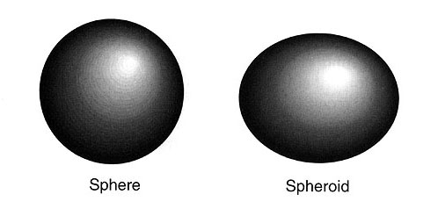
Earth’s Shape??
Earth is most accurately described as an oblate spheroid (almost a sphere)
Wider at the equator
12,714 km N to S
12,756 km E to W

Slide 38
A map is a drawing of the Earth (or part of it) on a flat surface.
The most accurate representation of Earth is spherical, called a globe.
Maps and globes are drawn to scale. This means the distances on the map are accurately compared to actual distances on Earth.
Example: 1 cm on map = 10 km on Earth
Cartography – the science of map making
Cartographer is a map maker

Slide 39
Latitude
Globes and Maps are marked off by horizontal lines called parallels.
Equator: The main parallel located halfway between the North and South poles.
The parallels are used to measure distance north or south of the equator.
This measure is known as latitude.
The equator is 0° latitude.
The North Pole is 90°N latitude.
The South Pole is 90°S latitude.

Slide 40
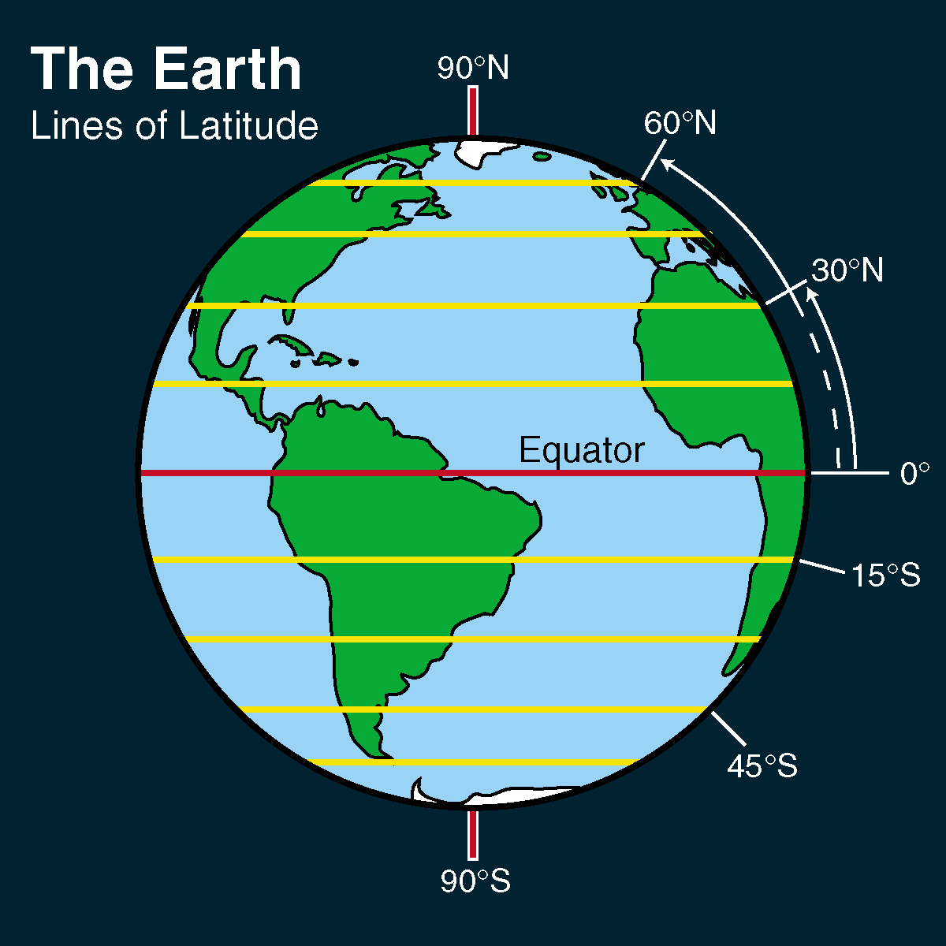

Slide 41
Longitude
Lines that run vertically (north to south) or from the North Pole to the South Pole are called meridians.
Meridians are used to measure distance east to west.
Geographers have named the meridian that runs through Greenwich, England the Prime Meridian.
The Prime Meridian is designated as 0° longitude.
Longitude: The measure east or west of the Prime Meridian.
All other points are measured as degrees east or west longitude.
The numbers go from 0° - 180°. (East AND West: 180°x2 = 360°, a full circle!)
Every 15 degrees longitude = one time zone. (24x15°=360°.)

Slide 42
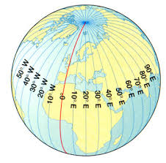

Slide 43
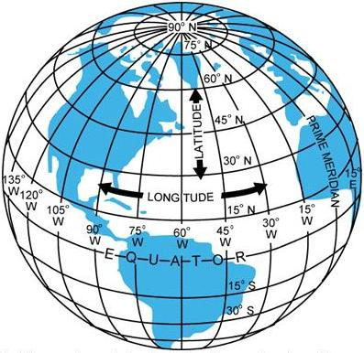

Slide 44
Globes and Maps
Each degree of latitude and longitude can be broken down further into smaller units.
Degree ➔ Minute ➔ Second
1 degree = 60 minutes
1 minute = 60 seconds

Slide 45
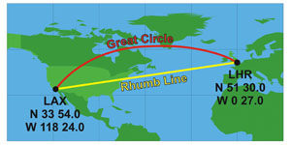
Navigation
Great Circles are used in navigation (by pilots). This is a pathway that divides Earth in half and is therefore the shortest route.

Slide 46
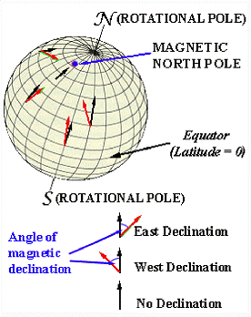
Geomagnetic Poles – points on Earth directly above imaginary magnets
Magnetic declination – the angle between the direction of the Geographic North Pole and the compass needle
True North – the direction of Geographic North Pole

Slide 47
Using the diagram in your notes:
Label the North Pole “N”
Label the South Pole “S”
Draw a red line to represent the Equator and a blue line to represent the prime meridian
Draw three lines of latitude north of the equator and label the degrees.
Draw three lines of longitude west of the Prime Meridian.
Label each line of longitude with the correct number of degrees in increments of 10 or 15
7 Label East and West

Slide 48
By 7:25, please:
1. Put up your phone
(# located beside your name to right of
phone holder)
2. Find your warm-up notebook. (in turquoise bin)
You will keep your warm-up book today. It is one of your best study tools for TOMORROW’S TEST.
(bring it back tomorrow)
YOUR NAME

Slide 49
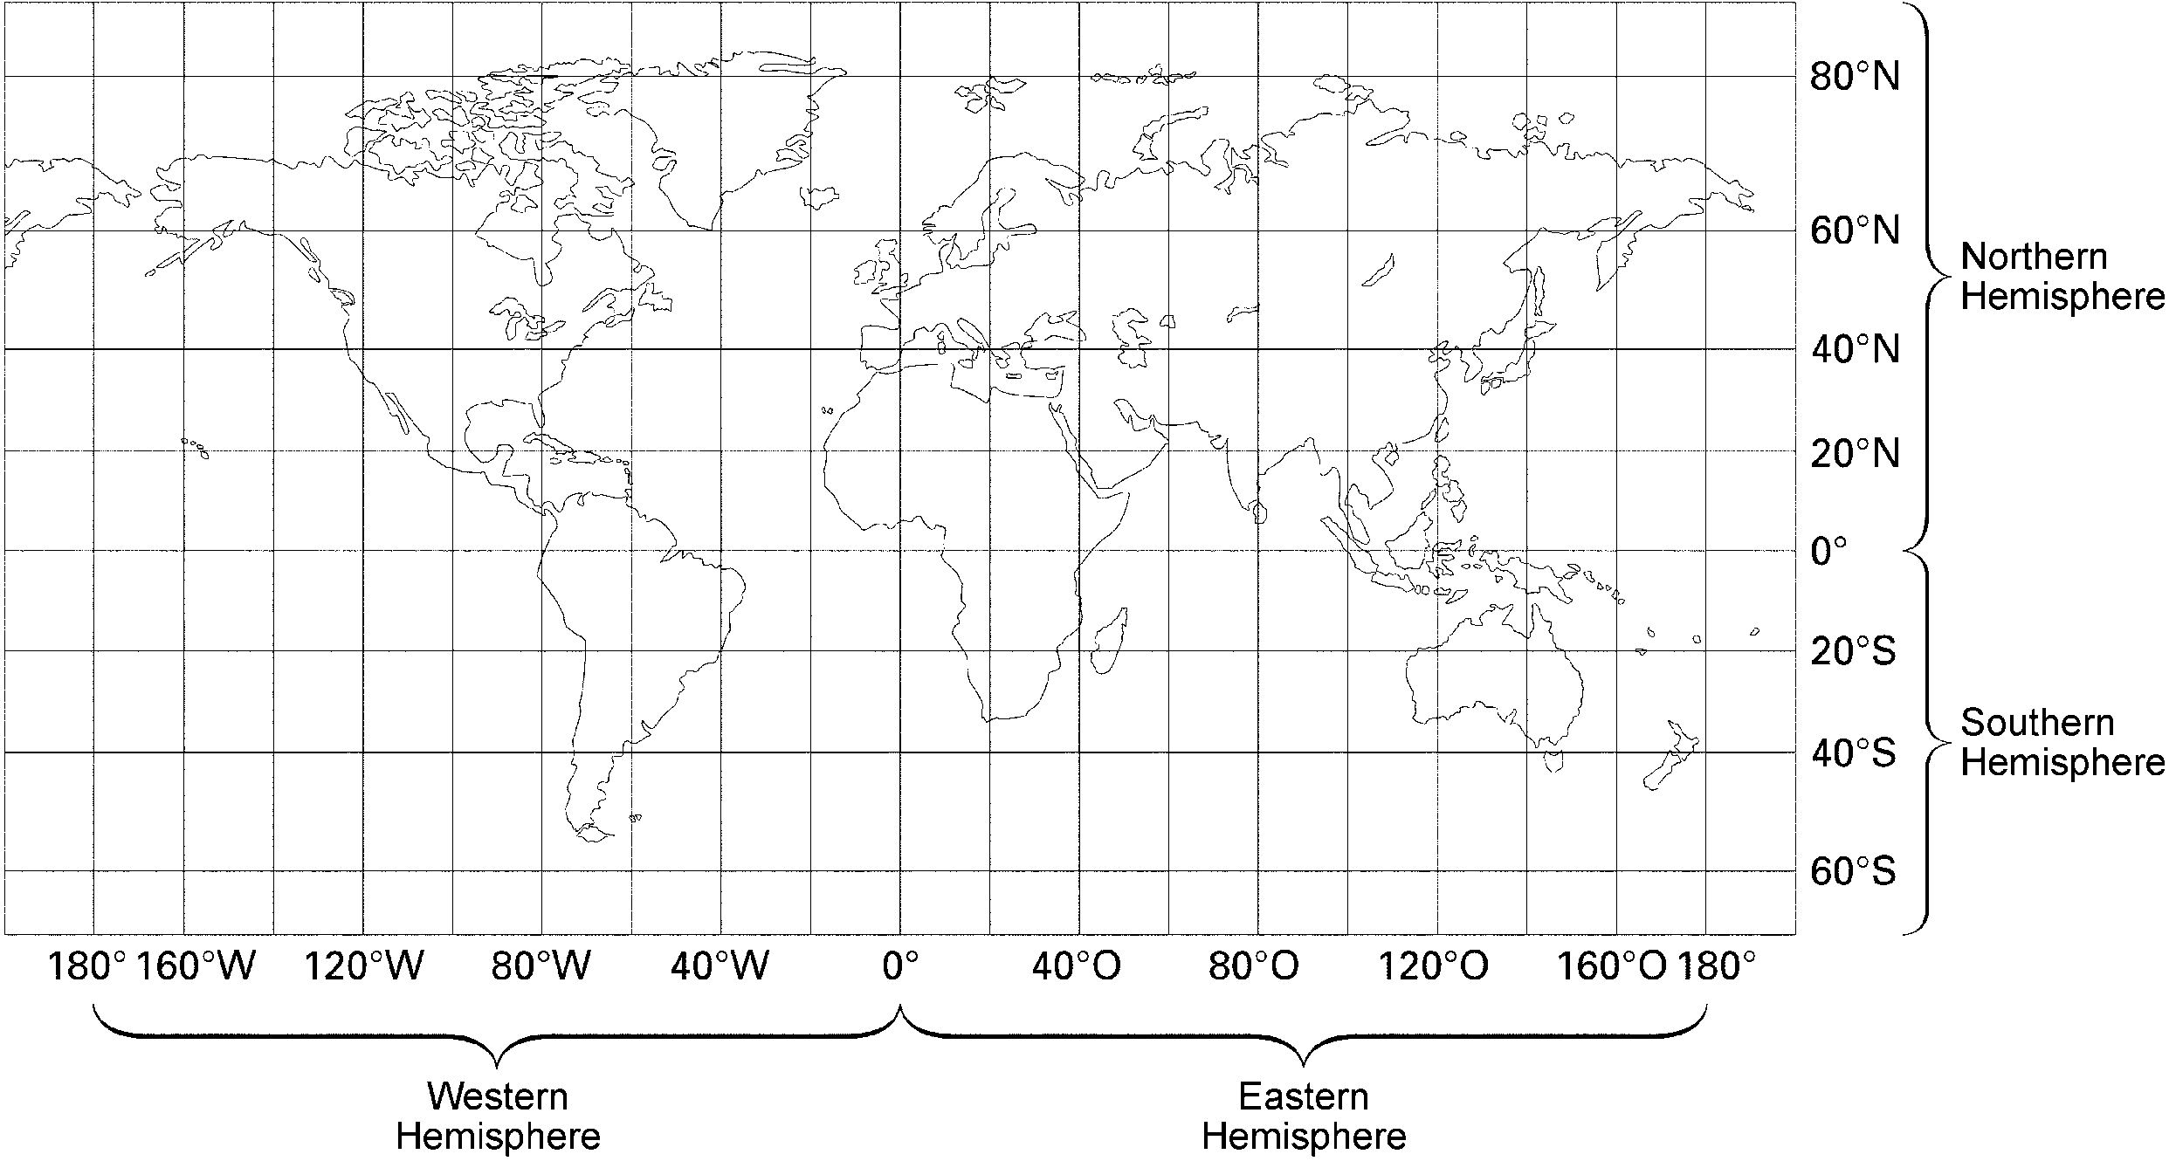
5 Feb 2020
A
70ºN, 100ºW
B
20ºN, 140ºE
What is the latitude & longitude of Point A?
For Point B?

Slide 50
Topographic Maps
http://www.rollanet.org/~conorw/cwome/hahatonka_topo_map.jpg

Slide 51
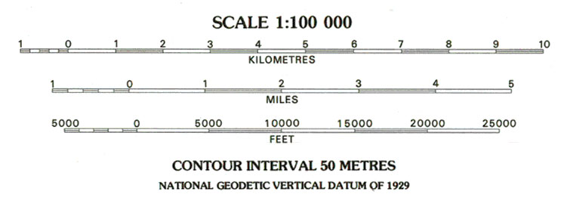
Topography: Surface features of an area.
Topographic Maps: Show the surface features of an area in detail (examples: mountains, hills, plains, rivers, etc.)
These maps all have scales that give a fixed ratio between a unit of measure on the map and the distance it represents on the surface. (Ex.: 1 cm on map = 80,000 cm on land)

Slide 52
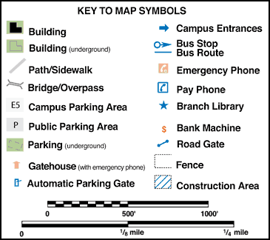
Colors on topographic maps:
Blue: Water (rivers, lakes, streams, etc.)
Green: Vegetation
Red: Contour Lines
There are many symbols used on the map. These are explained in the legend.

Slide 53
The most important feature on a topographic map is that it shows the elevation of an area.
Elevation: Height above sea level.
Sea level is zero elevation (avg of high & low tide)
Elevation is shown by contour lines. These are lines drawn on a map to connect all points of the same elevation.
Each map will specify the distance of vertical change between contour lines. This is the contour interval.
Every 5th line is bold and called an index contour.

Slide 54
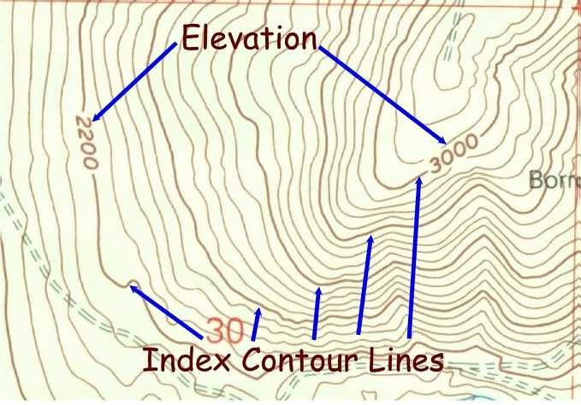

Slide 55
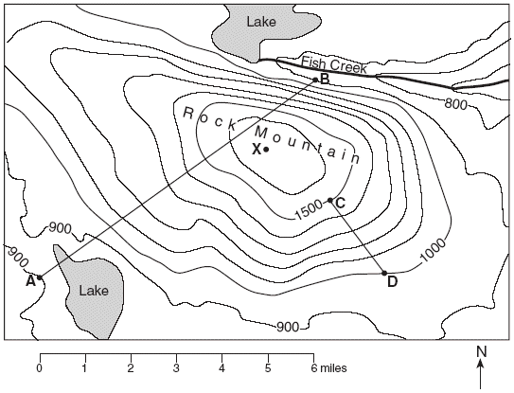
E

Slide 56
Relief describes how much variation in elevation an area has.
Examples: An area of high relief = many hills and valleys.
An area of low relief = plains or coastal region.
Relief is a numeric value that is the difference in highest and lowest elevation. (high – low = relief)
Hachure: Line used to show depressions on a topographic map.
Drawn at a right angle to contour line and points toward the lower elevation.

Slide 57
Depression (shown using hachures)

Slide 58
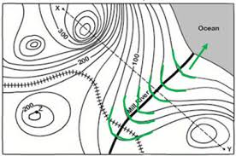
Closed loops indicate a hill.
Closely spaced contour lines indicate a steep slope.
Widely spaced contour lines indicate a gentle slope.
V-shapes contour lines indicate a valley and the “V” will always point upstream.
steep
gentle

Slide 59
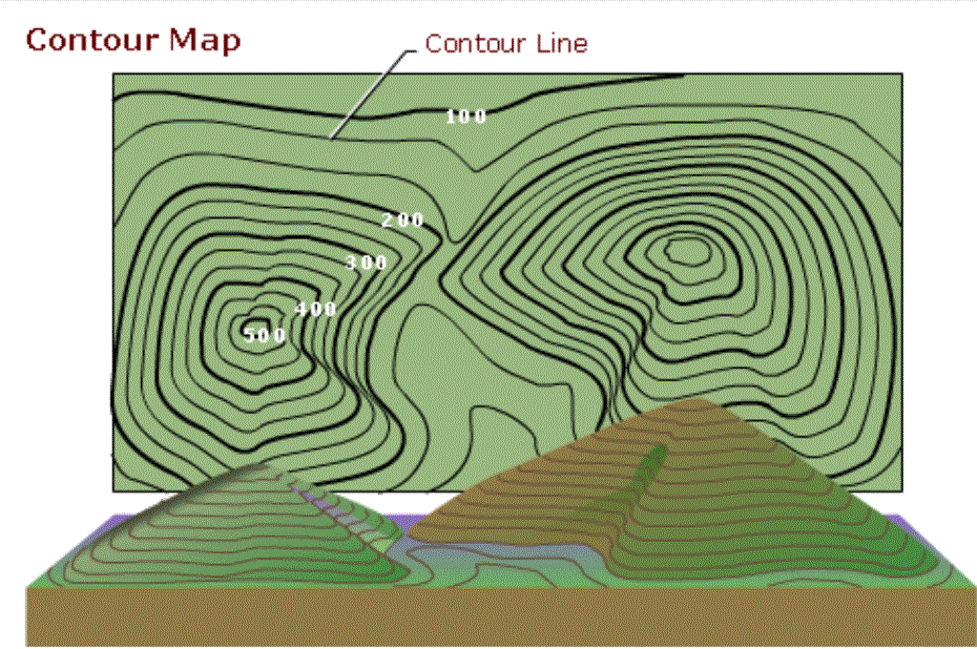

Slide 60
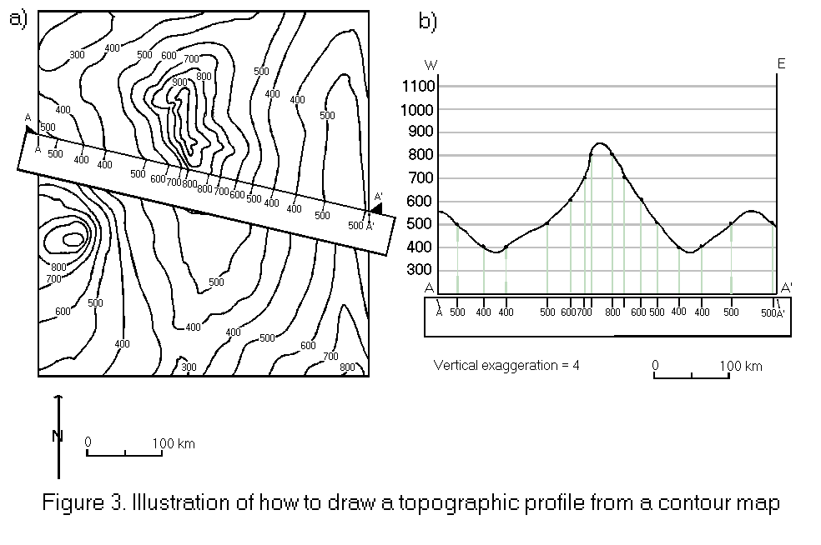

Slide 61
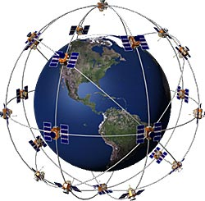
Advanced Technology: Gives us the ability to measure and analyze the physical properties of Earth with much greater precision.
Examples: GPS and Weather satellites.

